Slide 1

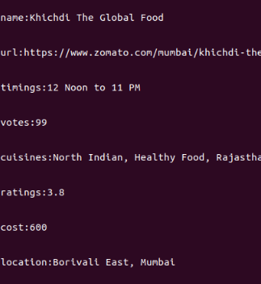
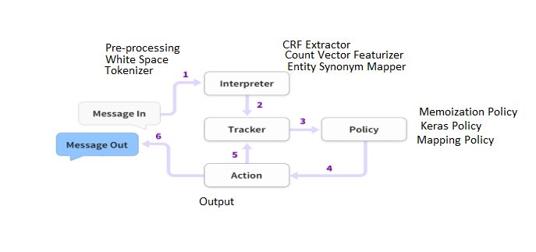
BE EXTC Project Presentation
Chatbot using Rasa NLU
Manish Katheeth, Yashvi Desai, Nikhil Mishra, Chinmay Tawde
Project Guide:- Prof. Valentina Rani
Project Group No. 6A
Introduction
3. Policy receives current state and chooses an action to be taken next. 4. Chosen action is logged by the tracer. 5. Response is sent to the user.
A chatbot is a computer program which conducts a conversation via auditor or textual methods. Chatbots are typically used in dialogue systems for various practical purposes including customer service or information acquisition. Conversational systems are becoming eminent as a basis for human computer interaction as we seek more natural ways to integrate automation into everyday life. The proposed chatbot for restaurant is web based application on artificial intelligence.
Problem Statement:- To construct a domain-specific model to converse with humans for restaurant and cuisine suggestions.
so the user gets immediate response to the query without wasting any time.
Results / Findings
Acknowledgments
In the chatbot all the data will be stored in a fixed location and will be retrieved quickly. If we do not find a match then proposed system would ask user more questions in order to get the appropriate answer. After the research data would be fed into the database so all the responses would be related to the topic. The proposed system does cover a wide range of domains such as Generative based bot, information with nearby restaurants, or suggesting cuisine-wise restaurants, booking a table, etc. If no match found then our system will ask other relevant questions for better understanding of what the user wants.
We offer our sincere thanks to our project guide, Ms. Valentina Rani for her constant and timely help and throughout our preparation. We are grateful to all project coordinators for their valuable inputs to our project. We are also grateful to the college authorities and the entire faculty for their support in providing us with the facilities required throughout this semester.
Bibliography / References
[1] I. Sutskever, O. Vinyals, Q. Le ,” Sequence to Sequence Learning with Neural Networks” , ​Neural Information Processing Systems Conference. ​ ,in ​arXiv:1409.3215​ [cs.CL]​ , Dec 2014.
[2] O. Ludwig,” End-to-end Adversarial Learning for Generative Conversational Agents” ,in arXiv:1711.10122​ [cs.CL]​,November 2017.
[3] O. Vinyals, Q.Le ,”A Neural Conversational Model”,in arXiv:1506.05869 [cs.CL], July 2015.
[4] D.Braun, F.Matthes,” Towards a Framework for Classifying Chatbots”,​International Conference on Enterprise Information Systems (ICEIS), ​ vol.1, pp.​496-501,​ ​ May 2019.
[5] T.Bocklisch, J.Faulkner, N.Pawlowski, A.Nichol, “Rasa: Open Source Language Understanding and Dialogue Management”,in arXiv:1712.05181 [cs.CL] ,December 2017.
Methods / Procedures
Rasa is an open-source conversational AI framework which provides a set of tools to build a complete chatbot. Rasa consists of two main components - Rasa NLU and Rasa Core. 1. The message is received from the user and passed to the interpreter where it is converted into a dictionaryincludingoriginaltext,intentsandentitiesthatwerefound. This part is handled by NLU. 2. The tracker keeps track of the conversational table.
.
Conclusion / Discussions
The restaurant chatbot provides the details regarding the restaurant queries that are faced by the local people. The application provides all the details when asked the query regarding it. The proposed system uses Natural Language Processing (NLP) engine searches in the database, which is fed by us after the research and provides the user with best answers and all this takes place within seconds

